Slide 1
CCCA3
2023-2024

Slide 2
Learning outcomes:
By the end of this session, you should be able to:
Practice on various grammatical points
Practice persuasive essay
Practice vocabulary

Slide 3
Outline:
Modals of deduction in the present
Modals of deduction in the past
Active & passive voices
Conditional type 3
Defining vs non-defining relative clauses
Present perfect simple & continuous
Past perfect simple & continuous
Persuasive essay writing
Linking words
Vocabulary

Slide 4
Modals of deduction in the present

Slide 5

We use the modal verbs:
might, may and could + an infinitive form without to when we think it is possible that something is true:
I've lost my keys. They might be at work or they could be in the car.

Slide 6
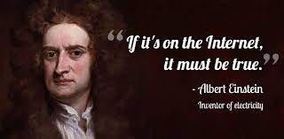
Must:
We use must when we are sure it is true:
That must be the main entrance. I can see people queuing to get in.
She must study very hard because she gets really good marks

Slide 7
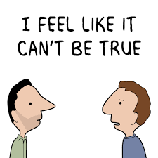
Can’t:
We use can’t when we are sure it isn’t true:
You can't be bored already! You've only been here five minutes.
They can't be poor because they have an incredible house and four cars.

Slide 8
Let’s practice

Slide 9
Write the correct modal verb to fill the gaps:
must
1. She’ s won prizes for her research. She _______________ be really intelligent.
2. I'd take an umbrella if I were you. It looks like it _______________ rain.
3. It _______________ be him. He's on holiday until next week.
4. Hey guess what?! I _______________ be getting a car for my birthday! It's not completely definite yet though.
5. I can't believe you've been waiting all this time! You _______________ be really bored.
6. His car's not here. He _______________ have gone out.
7. Look how much sugar and salt it's got in it! It _______________ be good for you.
8. Have you looked next to your computer? I think you _______________ have left your keys there.
may/might/could
can’t
may/might/could
must
must
can’t
may/might/could

Slide 10
Modals of deduction in the past

Slide 11
Modal verb +have+past participle
To make guesses or deductions about past actions or states we use a past modal of deduction.
must have:
We use must have + past participle when we feel sure about what happened.
Who told the newspapers about the prime minister's plans? It must have been someone close to him.

Slide 12
might have / may have:
We can use might have or may have + past participle when we think it's possible that something happened.
I think I might have left the air conditioning on. Please can you check?
can't have / couldn't have:
We use can't have and couldn't have + past participle when we think it's not possible that something happened.
Can't Have (Been) is used to refer to an incident in the near past, Couldn't Have (Been) is used for an event that happened way back in the past.
She can't have driven there. Her car keys are still here.

Slide 13
Let’s practice

Slide 14

Why were there no buses yesterday? Maybe it was the snow or they _____ been on strike.
must have
might have
couldn't have
You _____ seen her, surely! She was standing right in front of you.
must have
might have
can't have
Let's ask at reception to see if they have your keys. Someone _____ found them.
must have
might have
can't have

Slide 15
He _____ gone to Russia. He didn't have a passport.
must have
might have
couldn't have
I explained the homework but she did the wrong page. She _____ misunderstood me.
must have
may have
can't have
Oh no! My phone's not in my bag. I _____ left it at home.
must have
can have
couldn't have

Slide 16
The passive voice

Slide 17
Use:
The passive is often used :
When the subject is unknown, unimportant or obvious from the context.
e.g. The injured workers were rushed to the hospital.
When we want to place emphasis on the receiver of the action rather than the doer, or agent
e.g. Thousands of homes were destroyed by the hurricane.
To make more polite or formal statements.
e.g. The car was not cleaned.

Slide 18
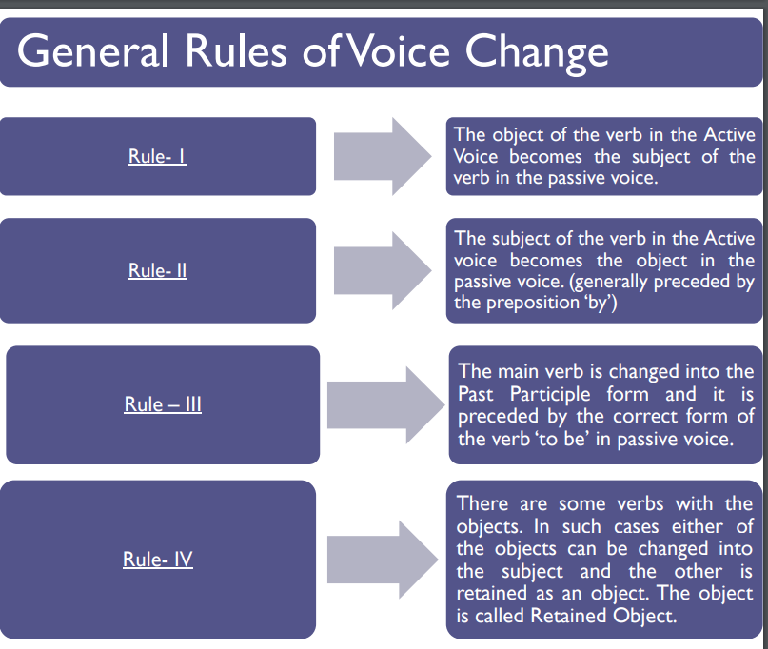

Slide 19

Compare the following sentences
Active
Passive
Sentence B is passive. That is the object of the active verb (eat) in the first sentence is the subject of the passive verb (is eaten) in the second sentence.
People eat sushi in many parts of the world
Sushi is eaten by many people in many parts of the world.
Sentence A is considered active because the doer of the action (or agent) is the subject of the sentence.

Slide 20
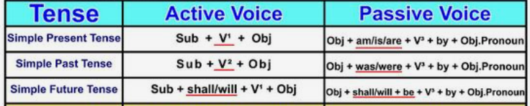
Form:
Passive : object + to be + past participle
Active : subject + verb

Slide 21
Let’s practice

Slide 22
Complete the sentences with the correct form and tense of the passive verb:
The accounts of our company _________ regularly twice a month by a strict tax expert.(check)
Romeo and Juliet ___________________ by Shakespeare. (WRITE)
Dinner _________________________ between 5 and 10 p.m. every day. (SERVE)
He _________________________ French when he spent his childhood there. (TEACH)
I _________________________ by the music so I couldn't concentrate. (DISTURB)
When ______ America ______ (discover)?
are checked
was written
is served
was taught
was disturbed
was
discovered

Slide 23
Third Type conditional

Slide 24
There are 4 main types of conditional sentences in English, often called if clauses.
These sentences are in two halves (clauses):
the if part (if clause)
the other part where you can use words such as can, will, may, might, could and would (main clause)
They describe the result of something that might happen (in the present or future) or might have happened but didn't (in the past)

Slide 25
The Third Conditional is a structure used for talking about unreal situations in the past.
Like the other conditionals, a third conditional sentence consists of two clauses, an “if” clause and a main clause:
If you hadn’t stopped quickly, we would have crashed.
I wouldn’t have gone to the party if you hadn’t persuaded me to go.
If I’d studied harder, I probably would’ve passed the exam.
As you can notice we create the third conditional by using the Past Perfect after ‘if’ and then ‘would have’ and the past participle in the second part of the sentence.

Slide 26
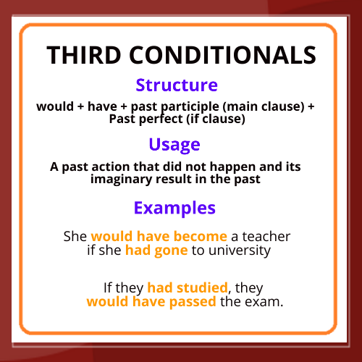

Slide 27
Let’s practice

Slide 28
Put the verbs in the correct form of Conditional Type III:
hadn’t taken
1- If you ………………………(not/take) so long making a decision, we would have signed the contract.
2- If you had read the paper, you ……………………………. (see) the advertisement.
3- Unless you had accepted the agreement, we ……………… (review/not) our terms.
4- If you had provided us with some leverage, we…….. ………………. (reconsider) the deal.
5- Provided you had increased your order by 10 %, we ……..…………. (give) you a discount.
would have seen
wouldn’t have reviewed
would have reconsidered
would have given

Slide 29
DRC vs NDRC

Slide 30
Relative pronouns
Relative pronouns take the place of nouns or pronouns. they are called relative pronouns because they relate back to something or someone.
They are used to join two sentences about the same person or thing.
Pronouns | Usage | Examples
Who | It replaces the subject pronouns,I, He, She, We,They | This is the man who broke the window.
Whose | Shows possession or relationship. | I have a friend whose mother drives a taxi.
Whom | It replaces the object pronouns me,her,him,us,them | The lady whom they caught was sent to prison.
Which | to refer to things. | Here is the car which she bought for her son.
That | to refer to either people or things. | She is a person that can be trusted.
Where | to refer to place. | This is the house where my son was born.
When | to refer to time. | The day when the concert takes place is tomorrow.

Slide 31
DEFINING RELATIVE CLAUSES
These describe the preceding noun in such a way to distinguish it from other nouns of the same class.
A clause of this kind is essential to clear understanding of the noun.
DRC has no commas.
In DRC, Relative pronouns (not always obligatory):
1/ who
2/ which
3/ that
The stairs which/that lead to the cellar are rather slippery.

Slide 32
NON-DEFINING RELATIVE CLAUSES
Non-defining relative clauses are placed after nouns which are definite already. They do not therefore define the noun, but add something to it by giving extra information about it.
They are not essential in the sentence and can be omitted without causing confusion. They are separated from their noun by commas.
The relative pronoun can never be omitted in a non-defining relative clause.
That block , which cost £5 million to build , has been empty for years

Slide 33
Defining or non-defining relative clause?
1/ My students who never do their homework will fail the exam.
2/ Valencia, which is Spain's third largest city, is on the Mediterranean coast.
3/ That dog whose bone you took is going to bite your leg off.
4/ They want to show me their new car they bought in Germany.
5/ The tree in front of my house, which I used to climb as a child, had to be cut down.
DRC
NDRC
DRC
DRC
NDRC

Slide 34
Make one sentence from the two that are given.
a. Ann took some photographs. Have you seen them?
b. You lost a key. Did you find it?
c.She’s the old woman. I often see her when I go to the shop.
d.Mont Blanc is between France and Italy. It is the highest mountain in the Alps.
E.Darwin. (His ideas changed our view of the world.) He travelled to a lot of countries when he was young.
Have you seen the photographs that Ann took?
Did you find the key that you lost?
She is the old woman whom I often see when I go to the shop.
Mont Blanc, which is between France and Italy, is the highest mountain in the Alps.
Darwin, whose ideas changed our view of the world, travelled to a lot of countries when he was young.

Slide 35
Present perfect simple and continuous

Slide 36
We use the present perfect simple with action verbs to emphasise the completion of an event in the recent past. We use the present perfect continuous to talk about ongoing events or activities which started at a time in the past and are still continuing up until now.
I’ve written the Politics essay. | Completed event.
I’ve been writing the Politics essay. | Ongoing activity: I’m still writing it.

Slide 37
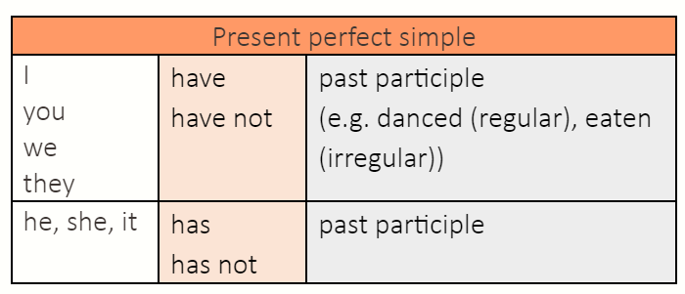
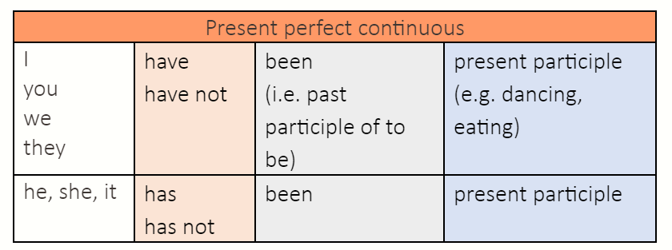

Slide 38
The Present Perfect Tense:
We use the present perfect simple to refer to events in the past which connect to the present.
Experiences
We’re going to Wagamama’s for dinner tonight. I’ve been there a couple of times before.
Recent completed events
The company employs around 400 staff and has recently opened an office in the UK.
Past events, present results
I had a car accident yesterday. I have broken my arm.

Slide 39
The Present Perfect Continuous Tense:
The present perfect continuous focuses more on the continuous action. The emphasis is on the duration of the action.
Example:
It began raining two hours ago.
It is STILL raining now.
*It has been raining for two hours.

Slide 40
Mental process and stative verbs
Some verbs are not used very often in the continuous form.
We don’t use the continuous form with verbs of mental process (know, like, understand, believe):
They haven’t known each other for very long.
Not: They haven’t been knowing each other for very long.
We don’t use the continuous form with verbs of the senses (hear, smell, taste):
Have you heard the news?
Not: Have you been hearing the news?

Slide 41
Let’s practice

Slide 42
Present Perfect Simple or Present Perfect Continuous?
1. ___________________ (you / buy) your train ticket yet?
2. The kitchen is a complete mess! What ___________________ (the children / do)?
3. Julie ___________________ (learn) to drive for six years!
4. Amanda ___________________ (already / have) lunch, so she’ll meet us later.
5. How much coffee ___________________ (she / drink) this morning?
6. Simon ___________________ (write) three books.
7. I ___________________ (do) everything I needed to do today! Hurray!
8. It ___________________ (not / rain) all summer, so the garden is dead.
Have you bought
have the children been doing
has been learning
has already had
has she drunk
has written
have done
hasn’t rained

Slide 43
Past perfect simple and continuous

Slide 44
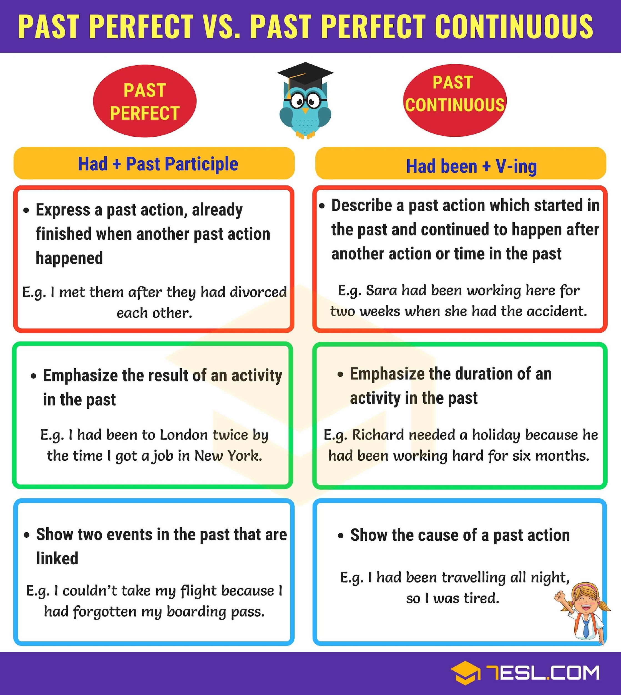

Slide 45
Let’s practice

Slide 46
Choose the correct alternative:
1. When I got home, I realized that while _________ someone stole my wallet.
had walked
have been walking
had been walking
2. I _______ the idea of going to a gym, but when I went to one for the first time last week, I liked it.
had always hated
have always hating
have always been hating
3. When the police were investigating the road accident, they discovered that the driver __________ in two other accidents before.
had been involved
had being involved
has been involved
4. __________ they __________ on the exams before the school put monitors in the classroom?
had they cheated
have they cheated
had they been cheating
Notes:
check

Slide 47
Persuasive Essay

Slide 48
Let’s practice

Slide 49
Reminder: The persuasive essay format
Set your position straight from the beginning, and maintain it throughout the paper.
A well-structured introductory paragraph coupled with a clear thesis.
Introduction
Topic or thesis you’re going to prove
Body
Body paragraphs validated with ample evidence and statistics.
Use logic and reason to show that your point of view is more legitimate than any other.
2 paragraphs ; each with a new argument and evidence to support your point of view.
Build the arguments in progression, so you’ll move from the least important to the most important one.
1 paragraph with the counter argument , explaining why you still disagree
A convincing conclusion.
Rewrite the main points in two or three sentences. This will reinforce your essay's argument, remind the reader what you were arguing for.
Conclusion
Remember!
A good persuasive essay demonstrates not only why the writer's opinion is correct, but also why the opposing view is incorrect.
Restate the thesis, summarize all arguments.

Slide 50
Persuasive essay
Body paragraphs
Each body paragraph should focus on one piece of evidence.
Opposing View Paragraph
Describe and then refute the key points of the opposing view.
Within each paragraph, provide sufficient supporting detail.
This paragraph strengthens the persuasive effect of the text.
Each separate point you make in defence of your thesis should be contained in a body paragraph of its own, and any facts, examples, stats, or quotes backing up that point included in the same paragraph.

Slide 51
Dos and don’ts
Persuasive Essay
Check |  |  | Check
 | Neutral Tone Some essays read too neutral, too informational, too expository. Write a conclusion paragraph that ends with a strong emotional appeal. | Have a thesis statement in your introduction Leave out opposing arguments Switch between arguments and sides in your essay
 | Persuasive Tone (voice and personality, and, most importantly, TONE!) | Use transition words

Slide 52
Linking words

Slide 53
Linking words:
Linking words, also called cohesive devices or conjunctions.
They are used to connect ideas, sentences or paragraphs.
They help build up coherent relationships within a paragraph or a text.

Slide 54
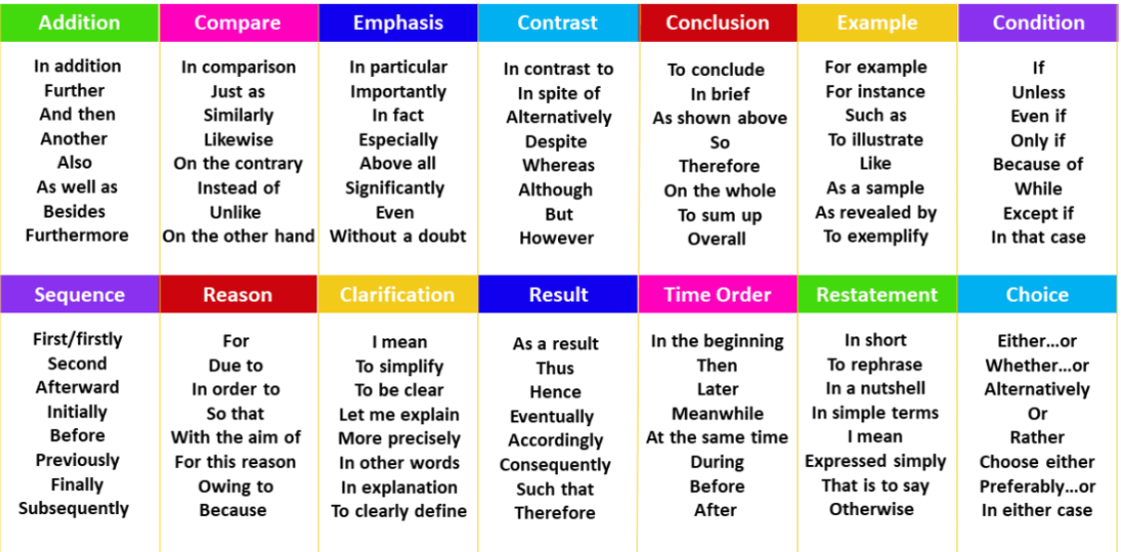

Slide 55
Let’s practice

Slide 56
Complete the sentences with the given linkers
although – at least – however - in case - including – in the meantime – on the contrary – otherwise – therefore – only if – as a result
1- Don’t forget to take some warm clothes with you, just _________ it gets cold at night
2- The report will be finished soon. _______________ , let’s get some coffee.
3- Sea levels will probably rise in the next few decades ____________ of global warming.
4- I hope he drives carefully, __________ he may have problems on such a slippery road.
5- The president was not a very popular leader. ___________ , his resignation did not come as a surprise.
6- Our economy will not improve this year. _____________ , all projections show that it will get worse.
7- The couple broke up a few days ago. _________ , they are still living together because of the children.
8- ________ it was a wonderful place to go skiing, not many tourists found their way there.
in case
In the meantime
as a result
otherwise
Therefore
On the contrary
However
Although
Notes:
.

Slide 57
Vocabulary

Slide 58
1-Prejudice is when someone has - - - - - - - (usually negative) about a person or group based on a stereotype
A. A belief
B. An assumption
C. An action

Slide 59
2- The act of blaming a person or group for something bad that has happened or that someone else has done :
A. Social inequalities
B. Social Categorization
C. Scapegoating

Slide 60
3-to eat a lot of food in a messy way:
A. to pig out
B. to be hyped
C. to drive someone up

Slide 61
4-Flogging a dead horse :
A. said when you want good luck or a good situation to continue
B. waste energy on something that has no chance of succeeding
C. try to hide a problem or keep a problem secret instead of dealing with it

Slide 62
5- Star Spangled Banner is:
a. The national anthem of the United States
b. The national flag of the United Kingdom
c. USA’s national Symbol
d. The national personification of the federal government of the US

Slide 63
6- They need to raise thousands of pounds for this project, so our 20-pound donation is just a drop in the bucket :
a. a very tiny part of something big
b. a hidden problem or keep a problem secret
c. a roadblock that prevents success
d. a waste of energy on something that will fail

Slide 64
7-Would I be stepping on someone’s toes if I asked to help out with the party arrangements?
A. Offending
B. Criticizing
C. Showing off

Slide 65
8-We had everything in line for the party, but having the caterer cancel on us at the last minute really threw a wrench in the works!
A. To help
B. To delay
C. To ruin

Slide 66

And finally,

Slide 67

THANK YOU FOR YOUR ATTENTION!

